Slide 1
Introduction to Splunk SIEM Tool
T.O Analytics

Slide 2
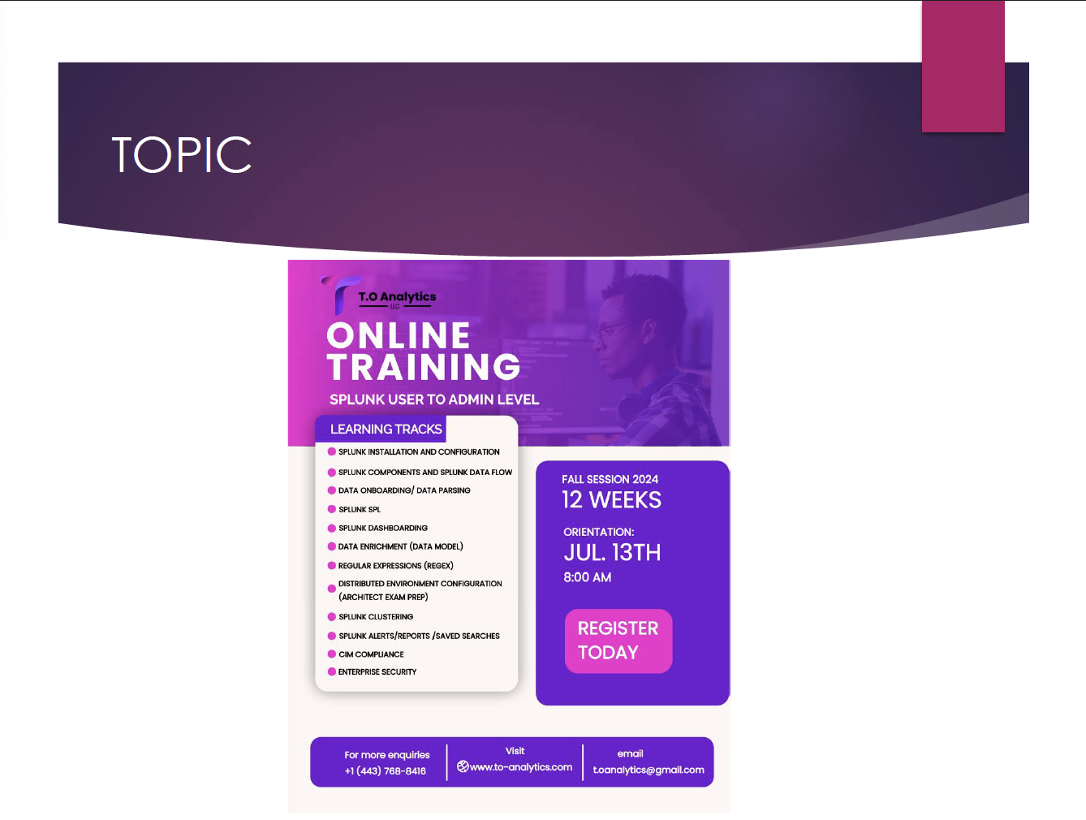


Slide 3


Slide 4

What is Splunk SIEM?
Splunk SIEM (Security Information and Event Management) is a software solution that provides real-time analysis of security alerts generated by applications and network hardware. It helps organizations to detect, respond to, and mitigate security threats.

Slide 5
How Splunk SIEM Works
Splunk SIEM collects and indexes machine data from various sources, including logs, events, and metrics. It then analyzes this data to provide actionable insights, alerting on suspicious activities, and enabling quick response to security incidents. Key components include data collection, indexing, searching, and reporting.

Slide 6
Who Uses Splunk SIEM?
Splunk SIEM is used by IT security teams, network administrators, compliance teams, and forensic investigators. It is widely adopted across various industries such as finance, healthcare, government, and retail.

Slide 7
Certifications Required for Splunk Jobs
Certifications that can help in getting a Splunk-related job include:
1. Splunk Core Certified User
2. Splunk Core Certified Power User
3. Splunk Enterprise Certified Admin
4. Splunk Enterprise Certified Architect
5. Splunk IT Service Intelligence Certified Admin
6. Splunk Certified Developer

Slide 8
How Much Can You Make?
Salaries for Splunk-related jobs can vary widely based on role, experience, and location. On average, a Splunk administrator can make around $85,000 - $135,000 per year, while a Splunk architect to Splunk Developer can earn between $150,000 - $240,000 per year and a Splunk representative expert/consultant can potentially make $250,000 to $360,000.

Slide 9
Types of Jobs in Splunk
Job roles related to Splunk include:
1. Splunk Administrator
2. Splunk Developer
3. Splunk Architect
4. Security Analyst
5. IT Operations Specialist
6. Data Analyst

Slide 10
Popular Companies Using Splunk
Many well-known companies use Splunk, including:
1. Intel
2. Coca-Cola
3. Cisco
4. ING
5. Dominos
6. Hyatt
7. Shazam
8. Tesco
9. Federal Government

Slide 11
Setting Up a Splunk Environment
To set up a Splunk environment:
1. Download and install Splunk Enterprise.
2. Configure data inputs to collect data from various sources.
3. Set up indexers and search heads.
4. Create and manage user accounts and permissions.
5. Monitor and maintain the Splunk environment.

Slide 12
Examples of Splunk Queries (SPL)
1. Search for failed login attempts:
`index=main sourcetype=access_combined status=401`
2. Find top 10 source IPs by event count:
`index=main | stats count by src_ip | sort -count | head 10`
3. Calculate average response time:
`index=main sourcetype=access_combined | stats avg(response_time)`

Slide 13
Splunk Dashboards
Splunk dashboards provide a visual representation of search results. They can include various charts, tables, and other visualizations to help monitor and analyze data in real-time. Users can create custom dashboards to meet specific needs.

Slide 14
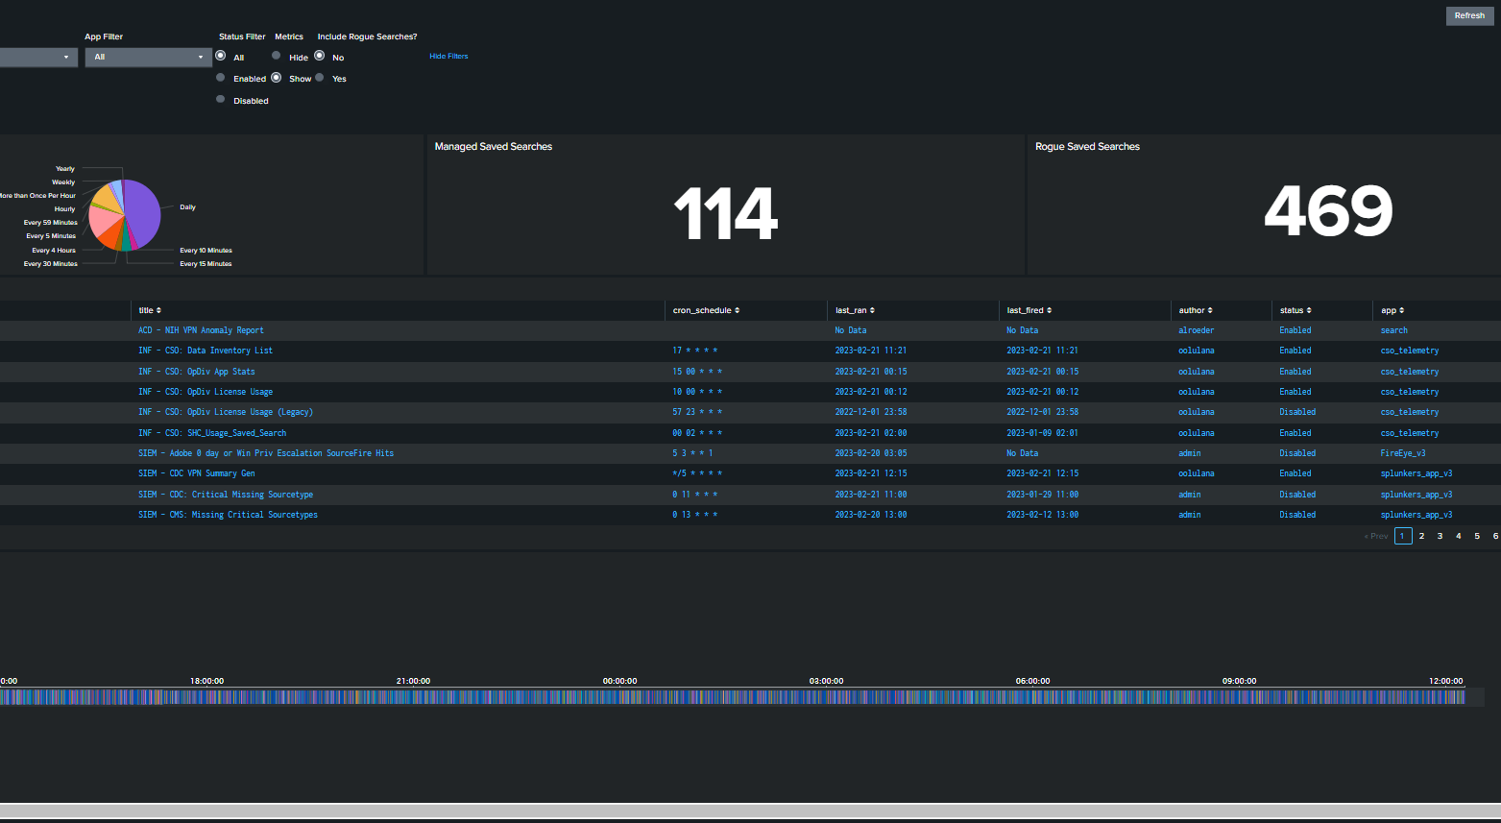
Splunk Dashboards

Slide 15
Graphs and Charts in Splunk
Splunk supports various types of visualizations including:
1. Line charts
2. Bar charts
3. Pie charts
4. Scatter plots
5. Histograms
6. Tables
These visualizations help in understanding data trends and patterns.

Slide 16
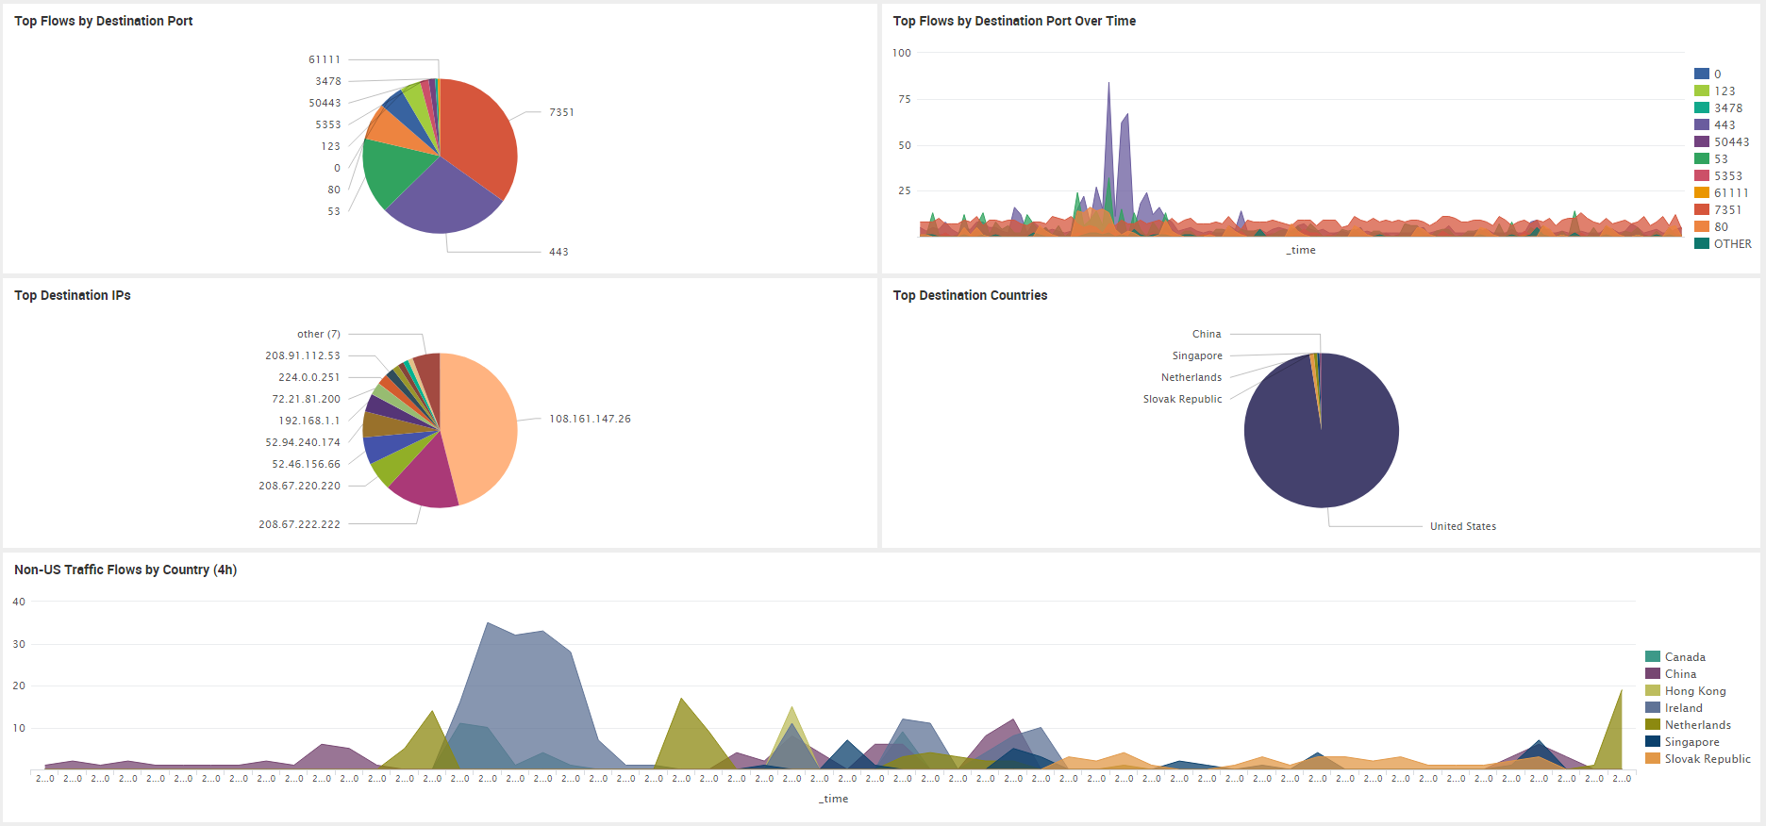
Classic Dashboard

Slide 17
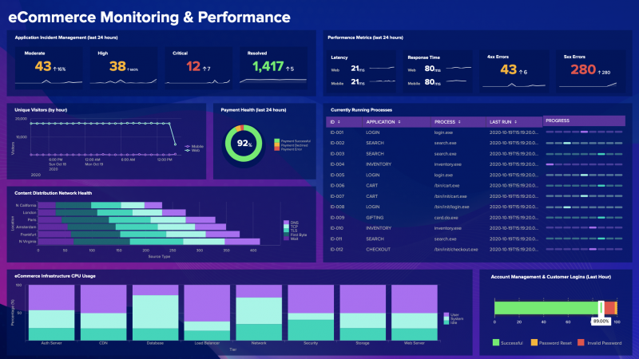
Dashboard Studio

Slide 18
Alerts, Saved Search and Reports
Splunk alerts are triggered when specific conditions in your data are met, allowing you to respond to critical events in real-time. Saved searches and reports enable you to store, schedule, and share search results, providing consistent and reliable insights for ongoing analysis and decision-making.

Slide 19
Splunk External Languages and tools
Python
Java
Linux
Html
Linux
SQL
AWS
Ansible
Gitlab
Json
SPL

Slide 20
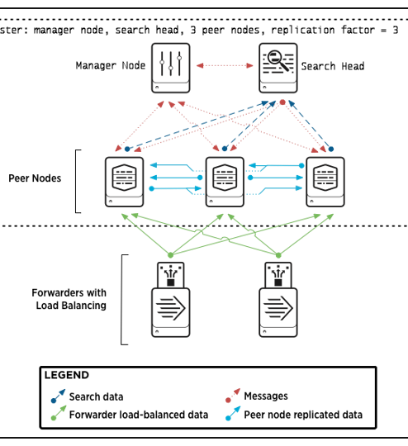
Splunk CLustering
Splunk clustering refers to the grouping of multiple Splunk instances to provide high availability, load balancing, and scalability. By distributing data and search load across multiple nodes, clustering ensures that the Splunk deployment can handle large volumes of data and numerous concurrent searches. This setup enhances the performance and reliability of the Splunk environment, making it a critical component for organizations that rely heavily on data analysis and real-time monitoring.

Slide 21
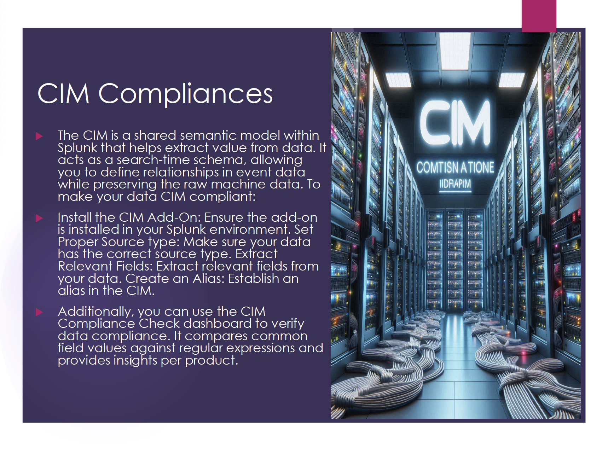

Slide 23
Advantages of Using Splunk SIEM
1. Real-time monitoring and alerting.
2. Scalability to handle large volumes of data.
3. Advanced analytics for threat detection.
4. Customizable dashboards and reports.
5. Integration with various security tools and platforms.

Slide 24
Challenges of Using Splunk SIEM
1. High cost of licensing and maintenance.
2. Complexity in setting up and managing.
3. Requires specialized skills and training.
4. Performance issues with very large datasets.
5. Ongoing need for tuning and optimization.

Slide 25
Future of Splunk SIEM
The future of Splunk SIEM includes advancements in:
1. Machine learning and AI for better threat detection.
2. Enhanced integration with cloud services.
3. Improved user interface and experience.
4. More robust automation for incident response.
5. Expanded capabilities for compliance and auditing.

Slide 26

Conclusion
Splunk SIEM is a powerful tool for security monitoring and incident response. With its real-time analysis, advanced analytics, and customizable dashboards, it helps organizations effectively manage and mitigate security threats. Continuous advancements in technology will further enhance its capabilities and value in the future.

